Slide 1
Intermolecular forces
Date
Task 1: I can demonstrate an understanding of the nature of intermolecular forces resulting from interactions between permanent dipoles, instantaneous dipoles and induced dipoles (London forces) and from the formation of hydrogen bonds (GRADE C)
Task 2: I can relate the physical properties of materials to the types of intermolecular force present, eg: i the trends in boiling and melting temperatures of alkanes with increasing chain length ii the effect of branching in the carbon chain on the boiling and melting temperatures of alkanes iii the relatively low volatility (higher boiling temperatures) of alcohols compared to alkanes with a similar number of electrons iv the trends in boiling temperatures of the hydrogen halides HF to HI (GRADE B)
Task 3:I can carry out experiments to study the solubility of simple molecules in different solvents I can interpret given information about solvents and solubility to explain the choice of solvents in given contexts, discussing the factors that determine the solubility including: i the solubility of ionic compounds in water in terms of the hydration of the ions ii the water solubility of simple alcohols in terms of hydrogen bonding iii the insolubility of compounds that cannot form hydrogen bonds with water molecules, eg polar molecules such as halogenoalkanes iv the solubility in non-aqueous solvents of compounds which have similar intermolecular forces to those in the solvent (GRADE A)

Slide 2
BIG picture
What skills will you be developing this lesson?
ICT
Numeracy
Literacy
Team work
Self management
Creative thinking
Independent enquiry
Participation
Reflection
How is this lesson relevant to every day life? (WRL/CIT)

Slide 3

Molecular forces (Task 1)
What is the difference between intermolecular and intramolecular?
(with respect to location and strength).

Slide 4
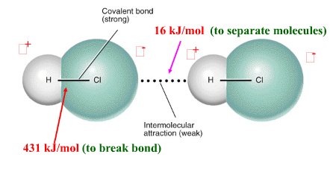
Intermolecular forces are attractive forces between molecules.
Intramolecular forces hold atoms together in a molecule.
Intermolecular vs Intramolecular
41 kJ to vaporize 1 mole of water (inter)
930 kJ to break all O-H bonds in 1 mole of water (intra)
“Effects” of intermolecular force
boiling point
Melting point
Physical state
ΔH_{vap}
Generally, intermolecular forces are much weaker than intramolecular forces.

Slide 5
Intermolecular Forces
1. Dipole-Dipole Interactions
2. London Forces (Dispersion Forces)
Instantaneous – instantaneous dipole forces
Instantaneous – induced dipole forces
3. Hydrogen Bonding

Slide 6
Which of the following molecules are polar (have a
dipole moment)? H₂O, CO₂, SO₂, and CH₄
O
S
H
H
O
O
dipole moment
polar molecule
dipole moment
polar molecule
H
H
C
H
O
C
O
no dipole moment
nonpolar molecule
H
no dipole moment
nonpolar molecule
10.2

Slide 7
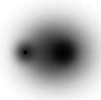
1. Dipole - Dipole interactions
δ⁺
δ–
Polar molecules have a permanent dipole that is, permanent separation of charge.
As a result, Molecules are attracted to each other in a compound by these +ve and -ve ends . This is called Permanent dipole – dipole interactions
H
Cl
δ⁺
δ–
δ⁺
δ–
δ⁺
δ–
δ⁺
δ–

Slide 8
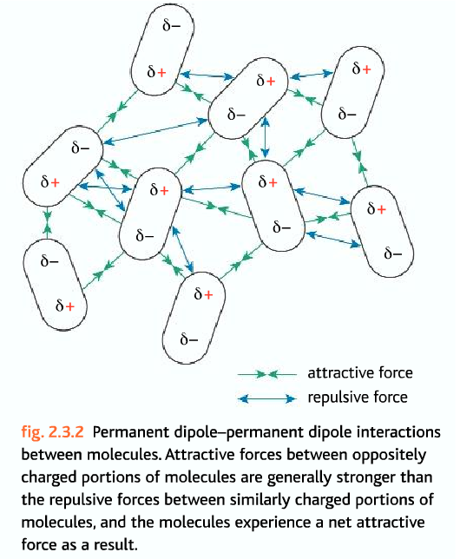
Dipole - Dipole interactions
What about the forces between non-polar molecules?

Slide 9



2. London forces (van der Waals forces)
In a symmetrical molecule like hydrogen, however, there doesn't seem to be any electrical distortion to produce positive or negative parts. But that's only true on average.
But the electrons are mobile, and at any one instant they might find themselves towards one end of the molecule, making that end -. The other end will be temporarily short of electrons and so becomes +.
An instant later the electrons may well have moved up to the other end, reversing the polarity of the molecule.

Slide 10

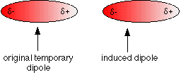
Imagine a molecule which has a temporary polarity being approached by one which happens to be entirely non-polar just at that moment.
As the right hand molecule approaches, its electrons will tend to be attracted by the slightly positive end of the left hand one.
This sets up an induced dipole in the approaching molecule, which is orientated in such a way that the + end of one is attracted to the - end of the other.

Slide 11
London forces
Instantaneous dipole:
Induced dipole:
Eventually electrons are situated so that tiny dipoles form
A dipole forms in one atom or molecule, inducing a dipole in the other
This diagram shows how a whole lattice of molecules could be held together in a solid using van der Waals forces.

Slide 12
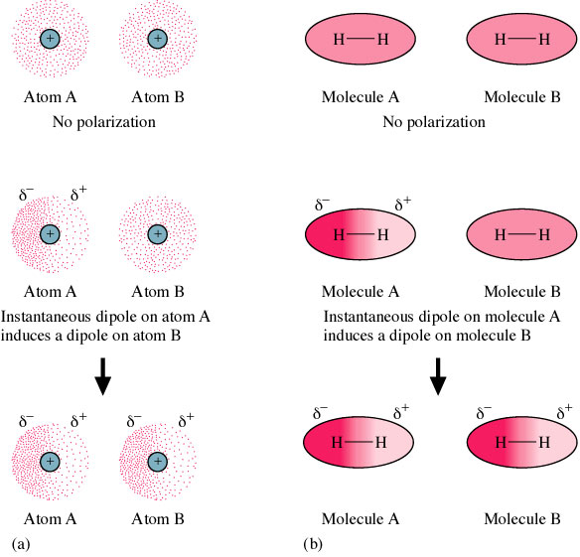
London
Forces –
Instantaneous dipole – induced dipole interactions

Slide 13

London dispersion forces –
Instantaneous dipole – instantaneous dipole interactions
This constant "sloshing around" of the electrons in the molecule causes rapidly fluctuating dipoles even in the most symmetrical molecule. It even happens in monatomic molecules - molecules of noble gases, like helium, which consist of a single atom.
If both the helium electrons happen to be on one side of the atom at the same time, the nucleus is no longer properly covered by electrons for that instant.

Slide 14
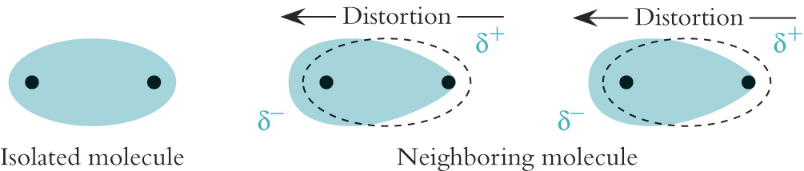
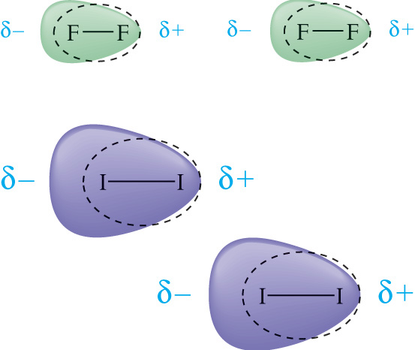
London Dispersion Forces
Figure 10-8 Olmsted Williams
The magnitude of the Dispersion Forces is dependent upon how easily it is to distort the electron cloud.
The larger the molecule the greater
it’s Dispersion Forces are.
So, larger the electron cloud more will be the London forces.

Slide 15
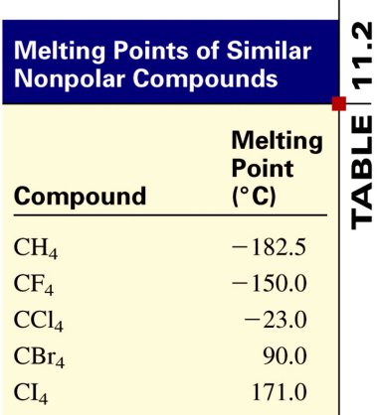
Polarizability
the ease with which the electron distribution in the atom or molecule can be distorted.
Polarizability increases with:
greater number of electrons
more diffused electron cloud
Dispersion forces usually increase with molar mass.

Slide 16
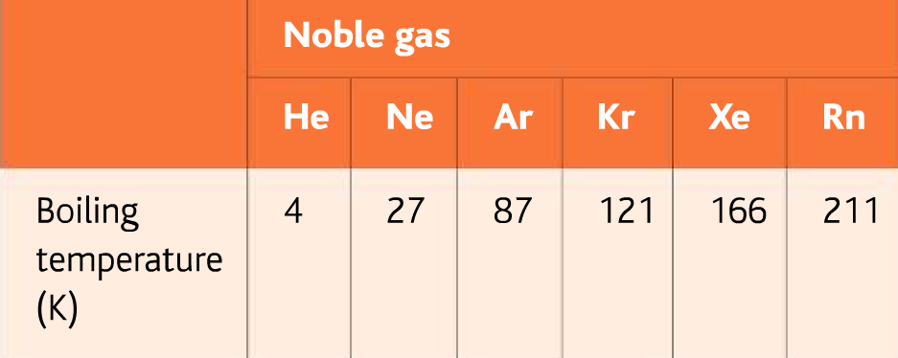
Explain the trend of boiling temperature of the Noble gases given below.
As you go down the group, Boiling point increases.
Because the atomic radii increases down a group and the london forces between the atoms increases.
Hence, the boiling point increases.

Slide 17
Intermolecular Forces
Explain why Ethane is a gas at room temperature while Hexane is a liquid.
The greater the surface area available for contact, the greater the London forces.
Hexane has larger surface area. So it has greater London forces than Ethane.
Due to stronger forces, molecules of Hexane are closer together and exist as liquid at room temperature while Ethane exists as a gas.

Slide 18
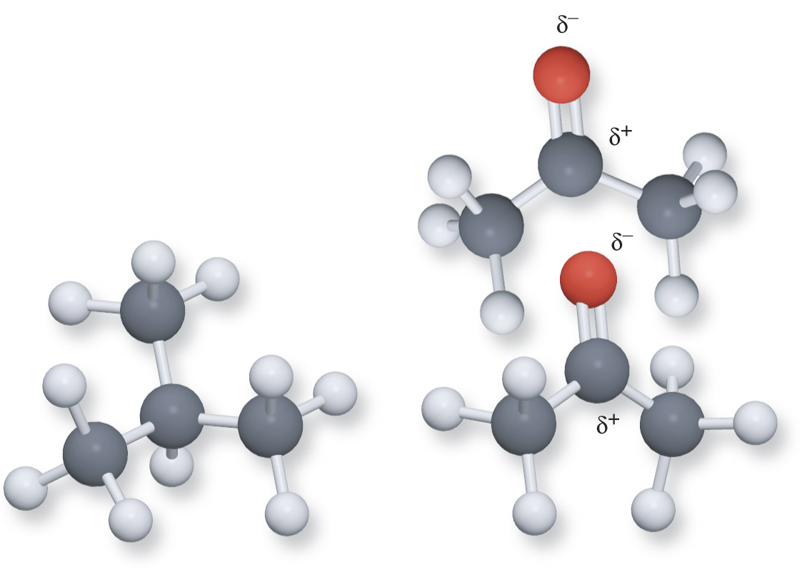
What type of forces exist between 2-methyl propane and acetone?
What will be the effect on boiling point?
Consider 2-methyl propane
(left) and acetone (right)
Both compounds are about
Equal in size and shape therby,
but Acetone contains an
Oxygen (red) and causes the
Molecule to have a dipole
Moment allowing it to have
Dipole forces and thus a
Higher boiling point

Slide 19
3. Hydrogen bonds
A special case of permanent dipole-dipole interactions
They are stronger than van der Waals forces.
Molecules with hydrogen bonds have higher boiling points than molecules that don’t.

Slide 20
Hydrogen bonds
What do you need?
A hydrogen atom covalently bonded to an electronegative atom … N, O or F.
A lone pair of electrons on the electronegative atom.
If only one of these conditions is met, you don’t get hydrogen bonding.

Slide 21
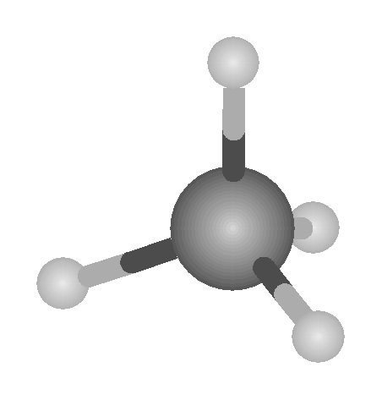
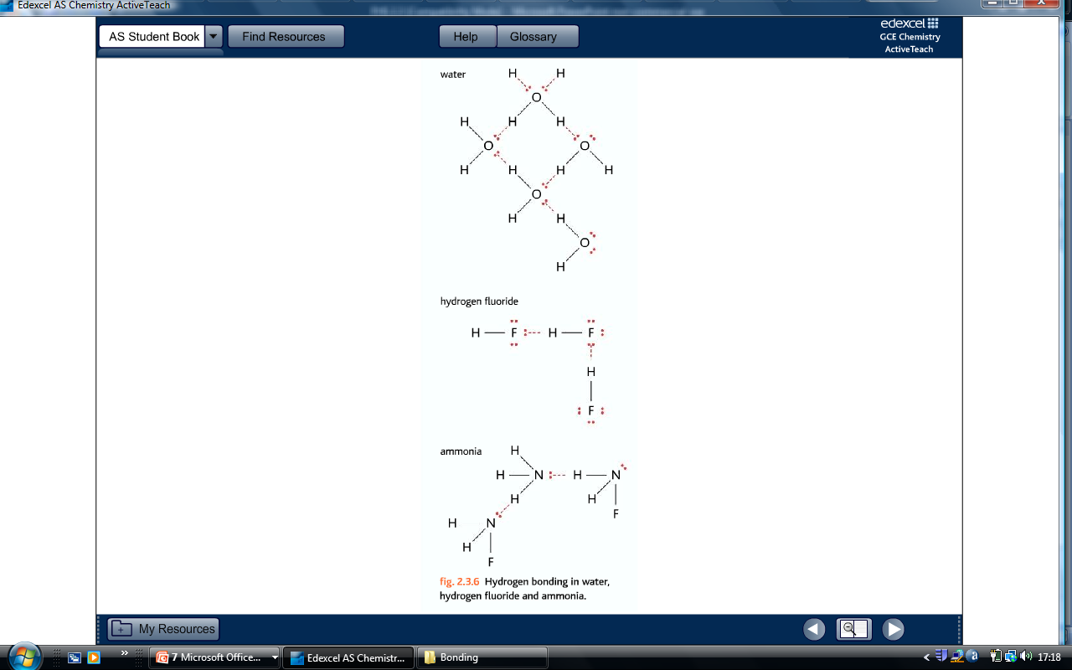
Hydrogen bonds
methane, CH₄ …
This does not have any hydrogen bonds. Carbon is not very electronegative, and it has no lone pairs of electrons in methane.

Slide 22
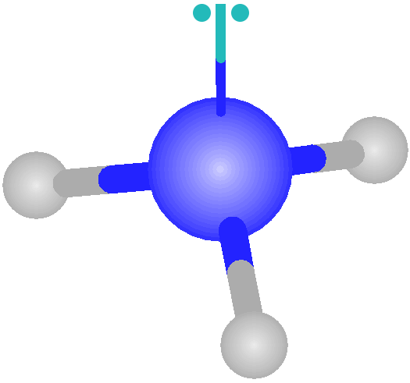
Hydrogen bonds
Ammonia, NH₃ …
H
H
This does have hydrogen bonds.
Nitrogen is very electronegative, and it has one lone pair of electrons in ammonia.

Slide 23
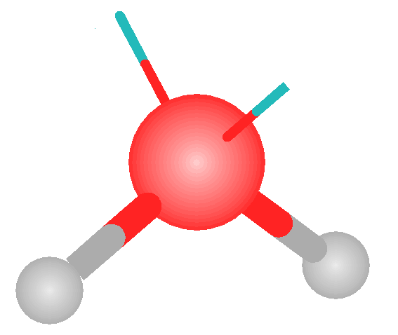
Hydrogen bonds
Water, H₂O …
This has not one, but two hydrogen bonds.
Oxygen is very electronegative, and it has two lone pairs of electrons in water.

Slide 24
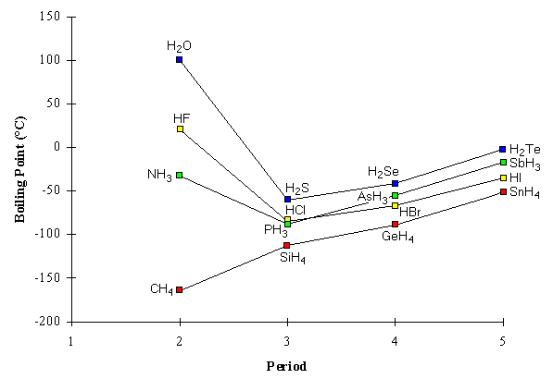
The boiling point of hydrides
Spot the trends shown in the graph
Group 6
Group 7
Group 5
Group 4

Slide 25
The common feature of these molecules are:
They contain small atomic number atoms which are strongly electronegative,
Which have lone pairs,
Which are bonded to hydrogen atoms.
Molecules without these features do not have unexpectedly high boiling points.

Slide 26
We can deduce from these observations that the hydrogen atoms in each molecule are unusually strongly attracted to the lone pair electrons on the strongly electronegative atoms with the same properties in other molecules.
It is clear from our boiling point data that hydrogen bonding interactions are much stronger than dipole-dipole attractions.

Slide 27
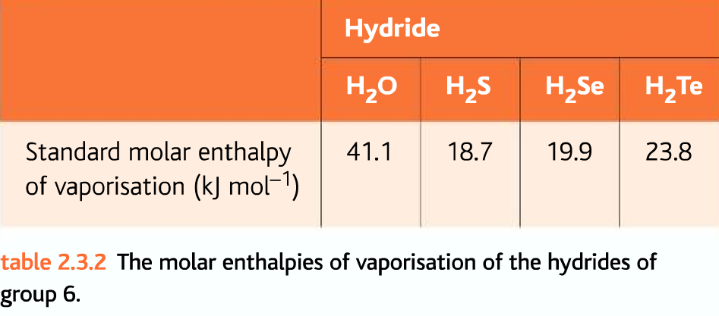
Standard Enthalpy of vaporisation?
It is the enthalpy change when one mole of a liquid changes into one mole of a gas at the boiling point under standard conditions.
Explain the trend of molar enthalpies of Vaporisation given below.

Slide 28
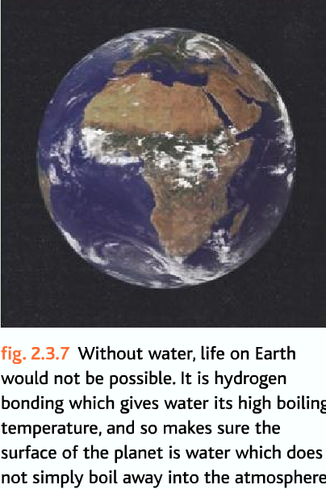

Slide 29
Hydrogen Bonding
Hydrogen bonding in water results in some unusual properties;
Higher than expected boiling point
High specific heat capacity (absorbs a lot of heat energy with only a small change in temperature)
Specific heat capacity is the measure of the heat energy required to increase the temperature of an object by a certain temperature interval.
Ice is less dense than water

Slide 30
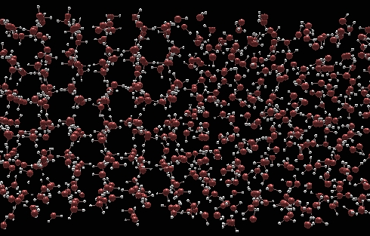
This section of water is frozen
This section of water is liquid

Slide 31
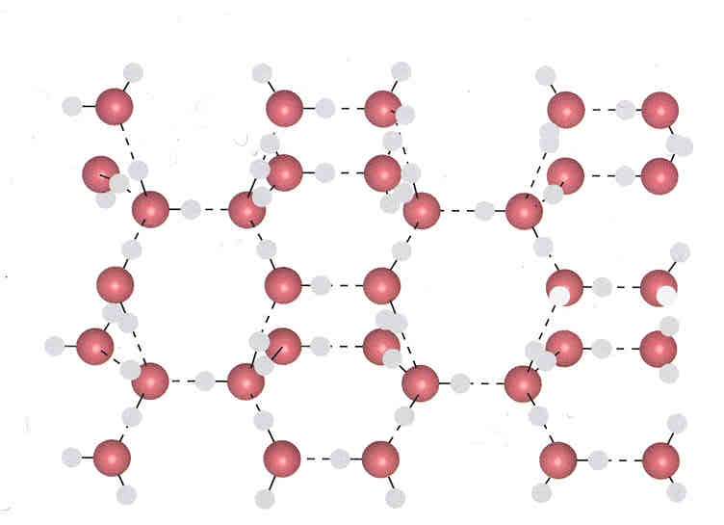
The ice structure has large empty spaces which gives it a lower density than water.

Slide 32
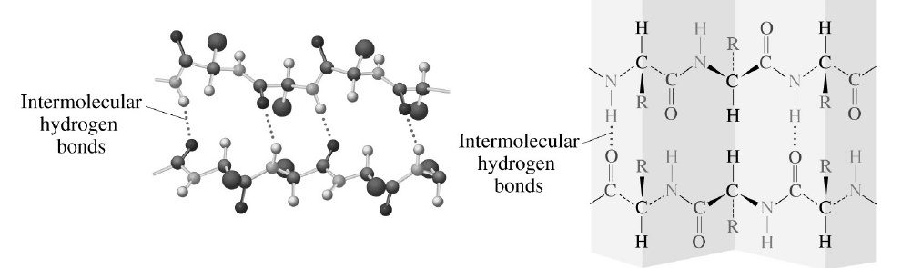
Intermolecular Hydrogen Bonds in Proteins
Intermolecular hydrogen bonds gives proteins their secondary shape, forcing the protein molecules into particular orientations, like a folded sheet …

Slide 33
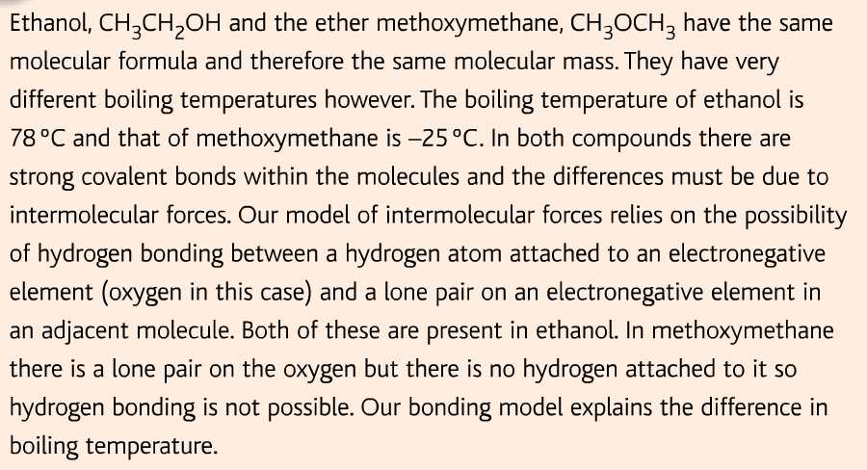
Question
Predict if Ethanol or Methoxymethane will have a higher boiling point than the other.

Slide 34
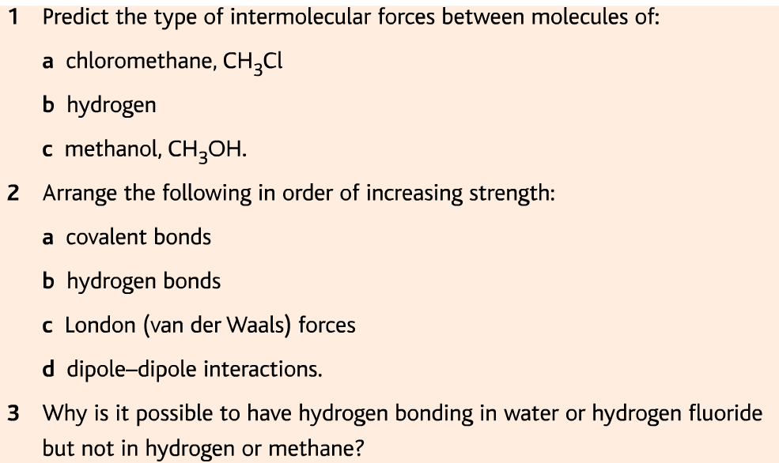
Questions

Slide 35
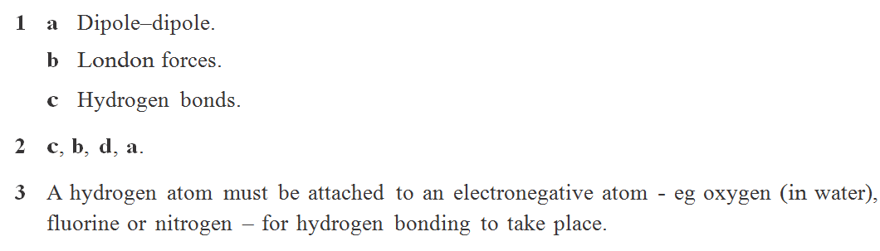
Answers

Slide 36
Task 1: Review
Go back to your lesson outcome grid and fill out the ‘How I did’ and the ‘Targets’ column.
Lesson Outcomes | How I did | Targets
Task 1: Grade C | Met? Partly met? Not met? | How can I improve on task 1?

Slide 37
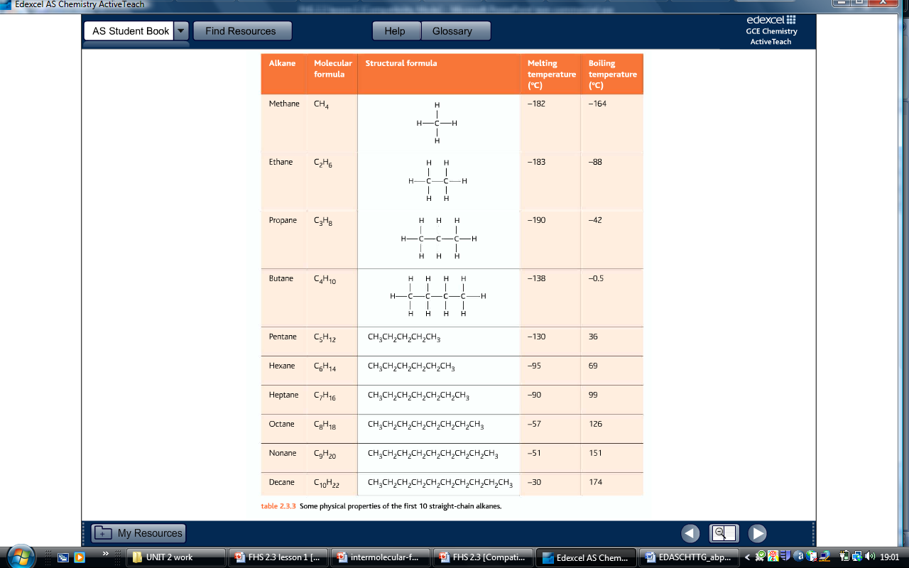
Trends in alkanes (Task 2)
Predict the trend of Melting point and boiling point in alkanes as the chain goes longer.
What is the type of intermolecular force found in alkanes?
Instantaneous – induced dipole forces

Slide 38
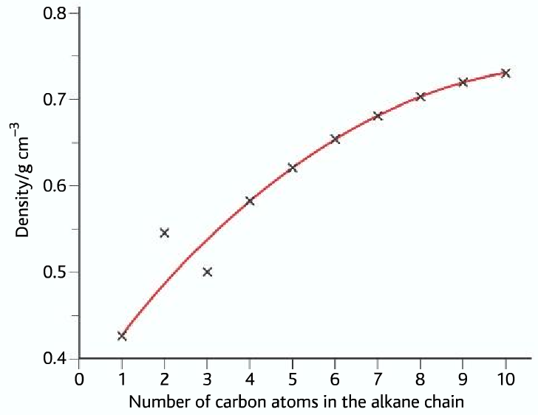
Explain the pattern (Task 2)

Slide 39
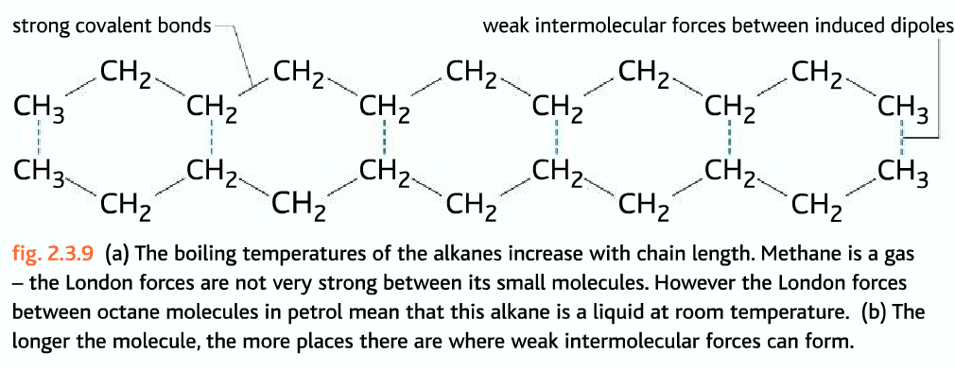

Slide 40
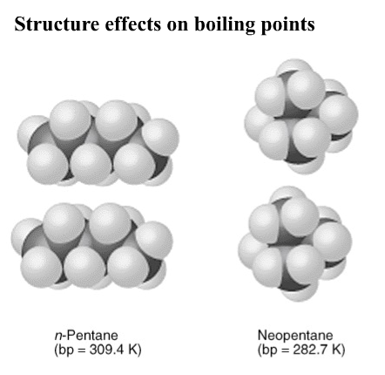
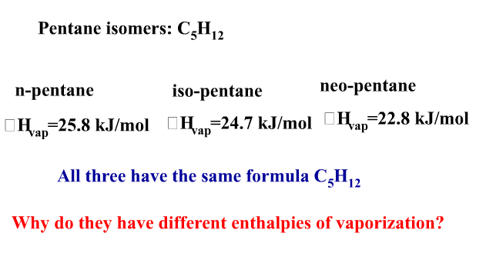
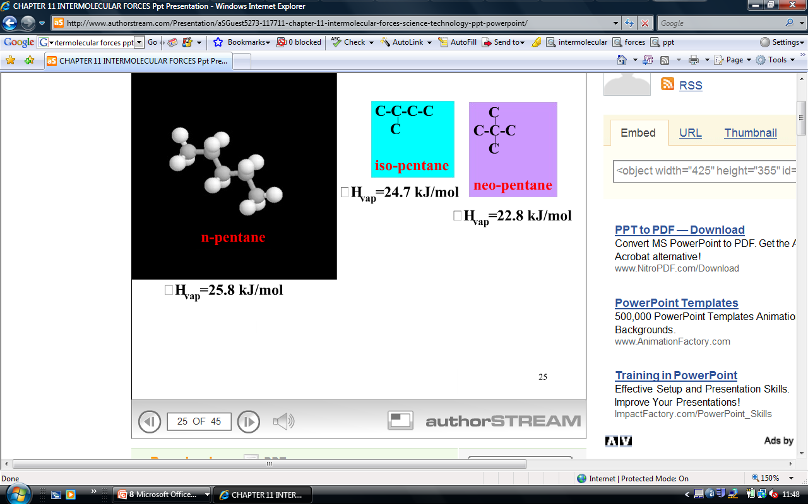
Question
The larger the molecule the greater it’s London dispersion forces are, More the Enthalpy of vaporisation.

Slide 41
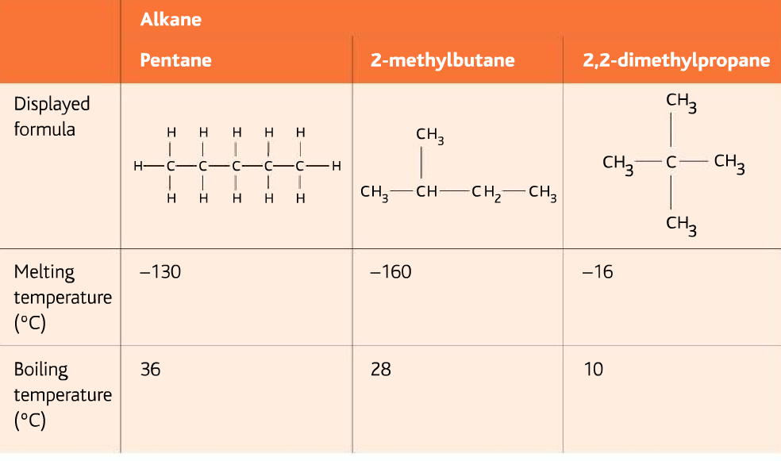
Explain the difference in BP and MP

Slide 42
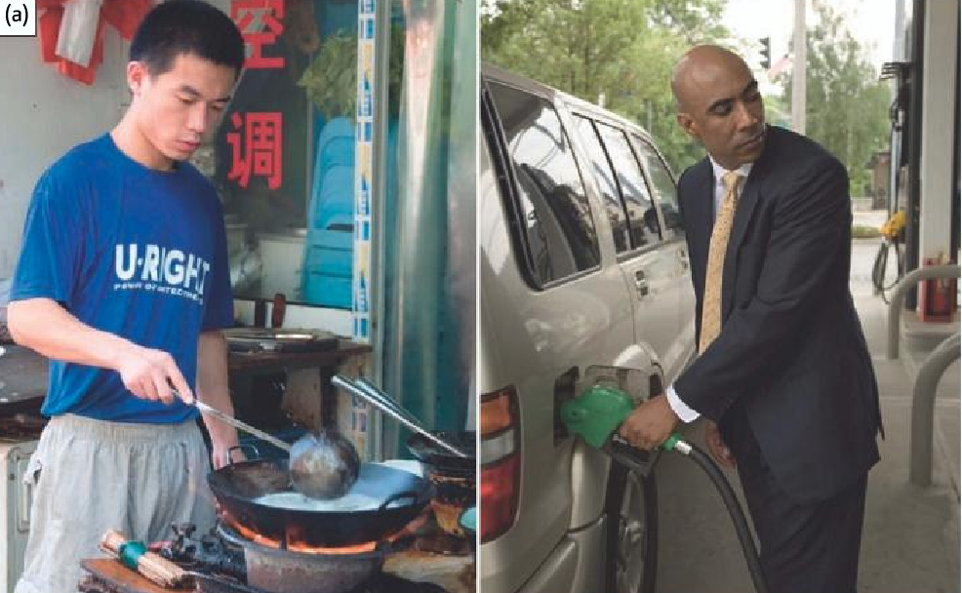
Why do the two fuels in the picture exist as gas and liquid?

Slide 43
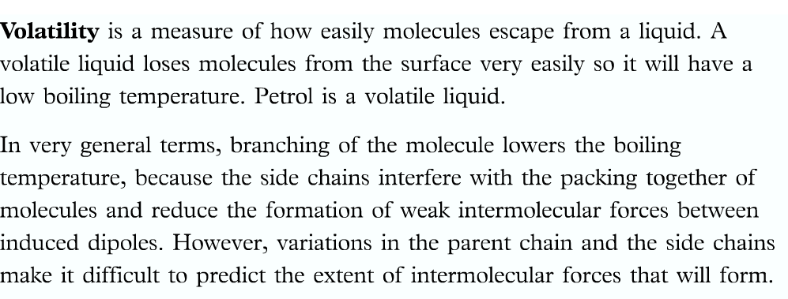
Volatility in alkanes

Slide 44
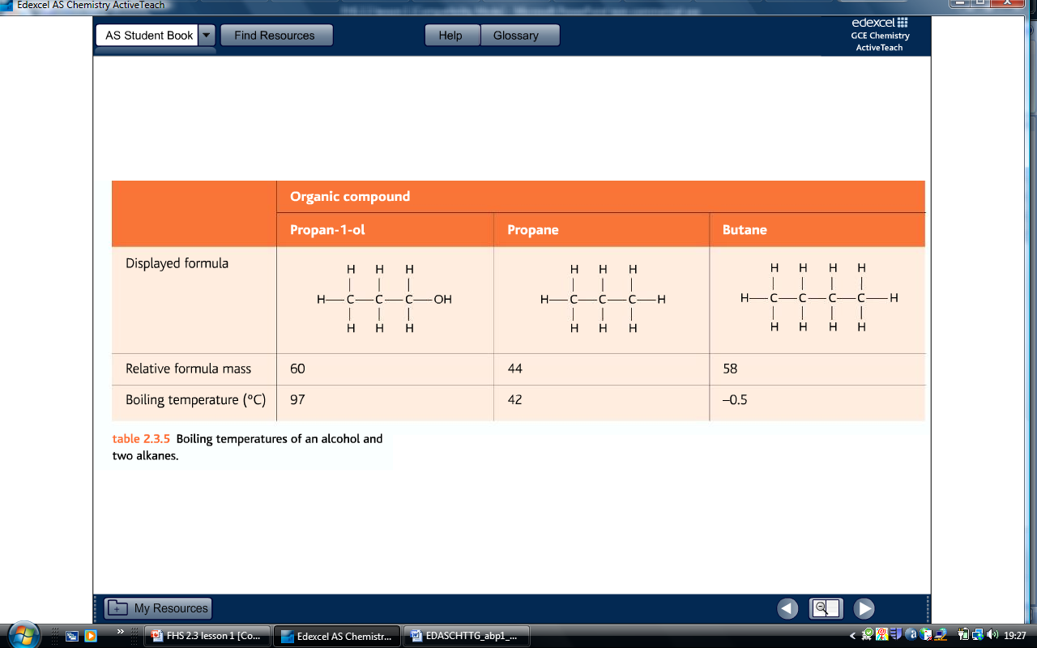
Explain the difference in BP

Slide 45
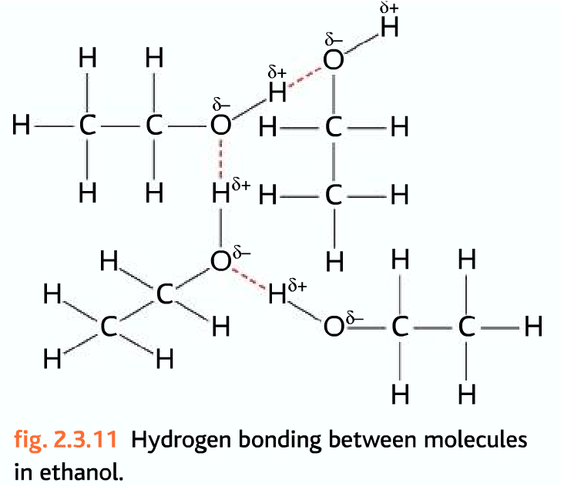
Hydrogen bonding in alcohols

Slide 46
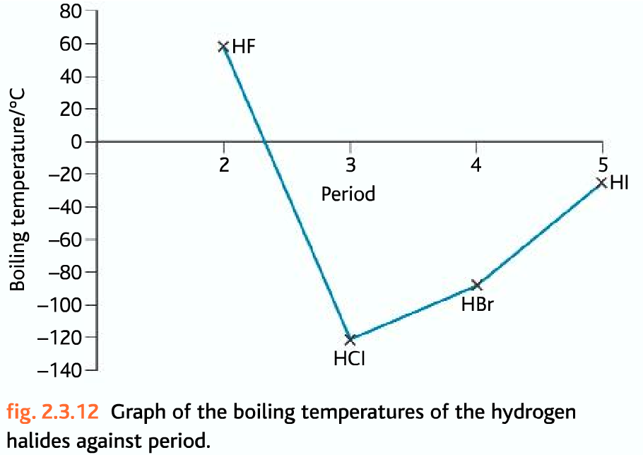
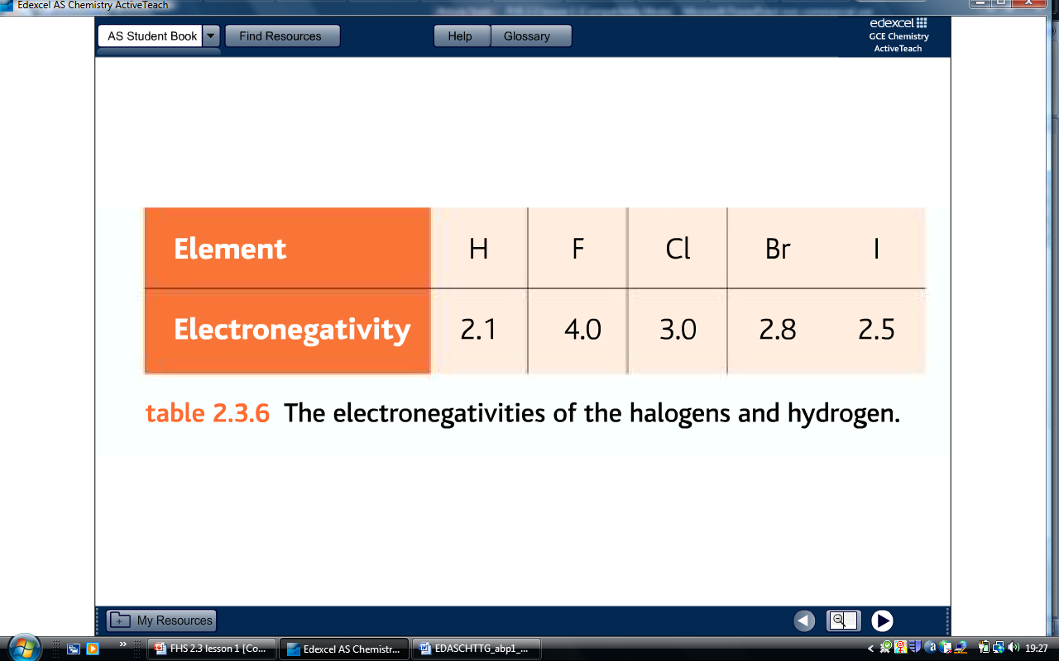
Explain the trend of the graph

Slide 47
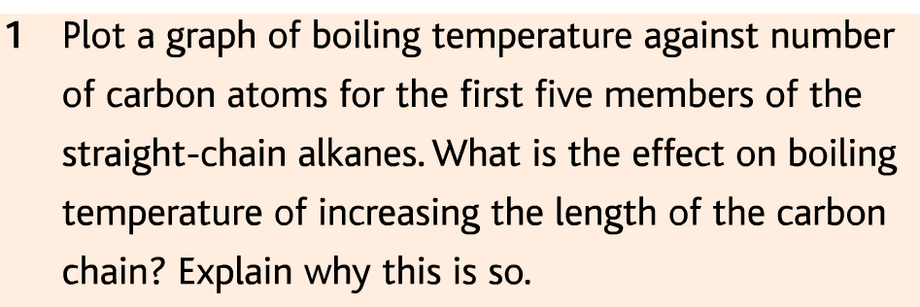
Question

Slide 48
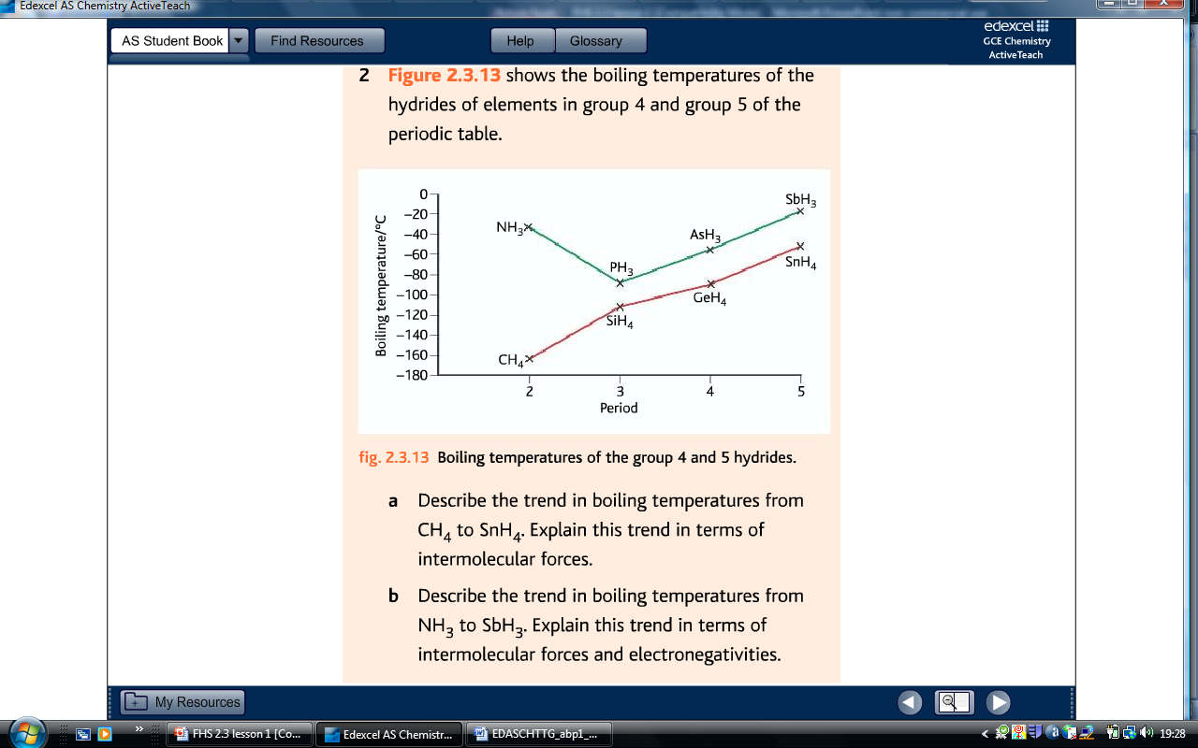
Question

Slide 49
Task 2: Review
Go back to your lesson outcome grid and fill out the ‘How I did’ and the ‘Targets’ column.
Lesson Outcomes | How I did | Targets
Task 2: Grade B | Met? Partly met? Not met? | How can I improve on task 2?

Slide 50
Homework
Homework task: Explain the three types of intermolecular forces giving examples. Also, plot a graph to show the variation of boiling points of hydrides of group 4,5,6 and 7
Due date: next lesson
Criteria for Grade C: Complete task
Criteria for Grade B: + Use of Autology
Criteria for Grade A: + Frame 5 Multiple choice questions with answers

Slide 51
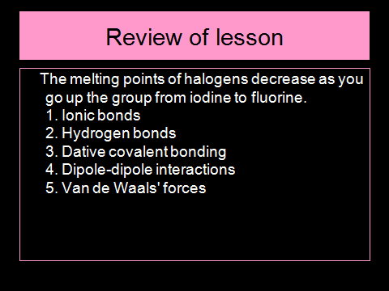
Review of lesson

Slide 52
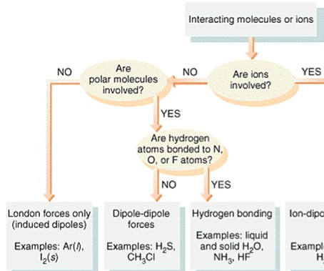
Summary

