Slide 1
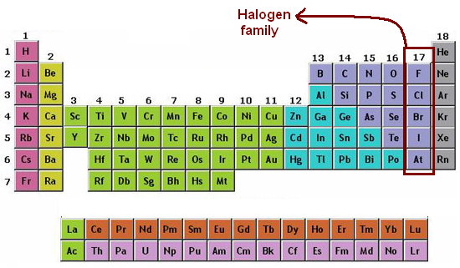

Slide 2
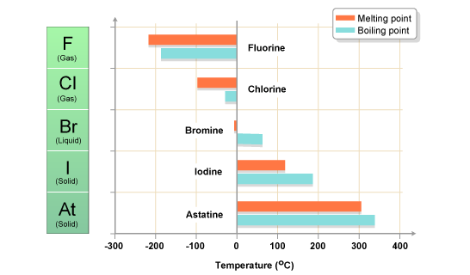

Slide 3
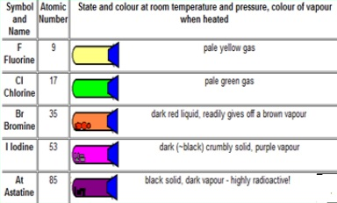

Slide 4
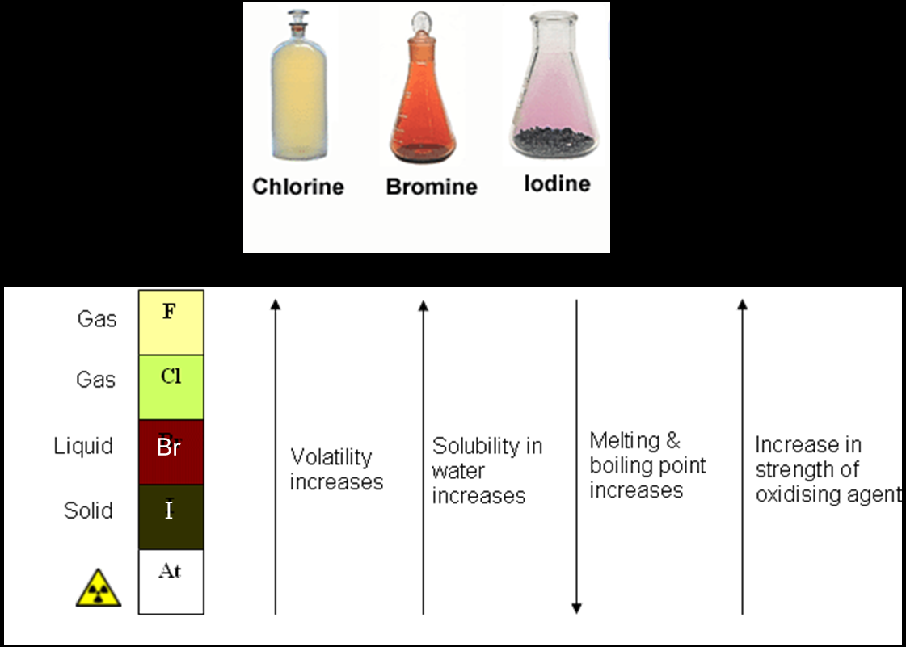

Slide 5
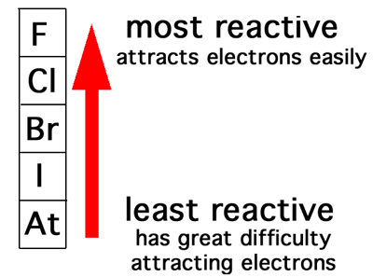

Slide 6
Displacement theory
If a metal halide is mixed with a more reactive halogen, the extra electron will be transferred from the less reactive to the more reactive halogen.
-
+
-
sodium
chlorine
chloride
Na
Cl
Cl
-
fluorine
fluoride
F

