Slide 1
Reactions of the halogens and halide ions
Halogen displacement reactions
http://www.youtube.com/watch?v=Y06IoBUeVbw
Test for halide ions
http://www.youtube.com/watch?v=7F4JhrBWdY4
Conc. Sulphuric acid and halides
http://www.youtube.com/watch?v=OoS3q1C8zts
Starch test for iodine
http://www.youtube.com/watch?v=6Zcfg6VW3e8

Slide 2
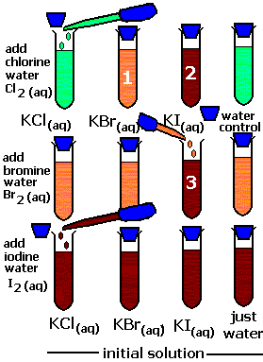
Halogen displacement reactions
Chlorine displaces bromine from potassium bromide and iodine from potassium iodide.
Bromine only displaces iodine from potassium iodide
Iodine cannot displace chlorine or bromine from their salts.
The most reactive element displaces a least reactive element
chlorine > bromine > iodine

Slide 3
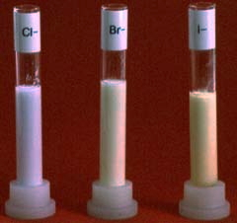
Test for Halide ions
This test has to be done in solution. If you start from a solid, it must first be dissolved in pure water.
The solution is acidified by adding dilute nitric acid. (Remember: silver nitrate + dilute nitric acid.) The nitric acid reacts with, and removes, other ions that might also give a confusing precipitate with silver nitrate.
Silver nitrate solution is then added to give:
The chloride, bromide and iodide precipitates are shown in the photograph:
The chloride precipitate is obviously white, but the other two aren't really very different from each other. You couldn't be sure which you had unless you compared them side-by-side.
ion present | observation
F⁻ | no precipitate
Cl⁻ | white precipitate
Br⁻ | very pale cream precipitate
I⁻ | very pale yellow precipitate

Slide 4
An alternative test for halide ions using concentrated sulphuric acid If you add concentrated sulphuric acid to a solid sample of one of the halides you get these results:
ion present | observation
F⁻ | steamy acidic fumes (of HF)
Cl⁻ | steamy acidic fumes (of HCl)
Br⁻ | steamy acidic fumes (of HBr) contaminated with brown bromine vapour
I⁻ | Some steamy fumes (of HI), but lots of purple iodine vapour (plus various red colours in the tube)

Slide 5
Test for Halide ions Part 2.
Confirming the precipitate using ammonia solution
original precipitate | observation
AgCl | precipitate dissolves to give a colourless solution
AgBr | precipitate is almost unchanged using dilute ammonia solution, but dissolves in concentrated ammonia solution to give a colourless solution
AgI | precipitate is insoluble in ammonia solution of any concentration

