Slide 1
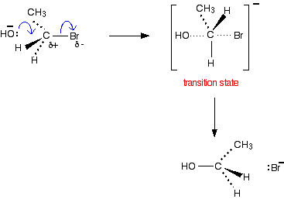
The S_{N}2 bimolecular nucleophilic substitution reaction
(Primary halogenoalkanes)
Be very careful when you draw the transition state to make a clear difference between the dotted lines showing the half-made and half-broken bonds, and those showing the bonds going back into the paper.

Slide 2
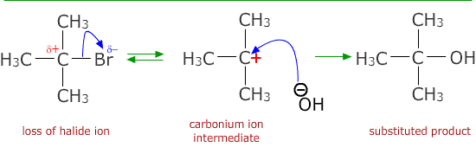
The S_{N}1 unimolecular nucleophilic substitution reaction
(Tertiary halogenoalkanes)

